Slide 1

IFTip Bot A crypto bot supports Near Aurora

Slide 2
Functions
IFTip supports Aurora:
1. Create wallet in very low threshold
2. Tip friends with Aurora ETH & ERC20 Tokens
3. Airdrop red packets to group users
4. Query price of Near and other tokens

Slide 3
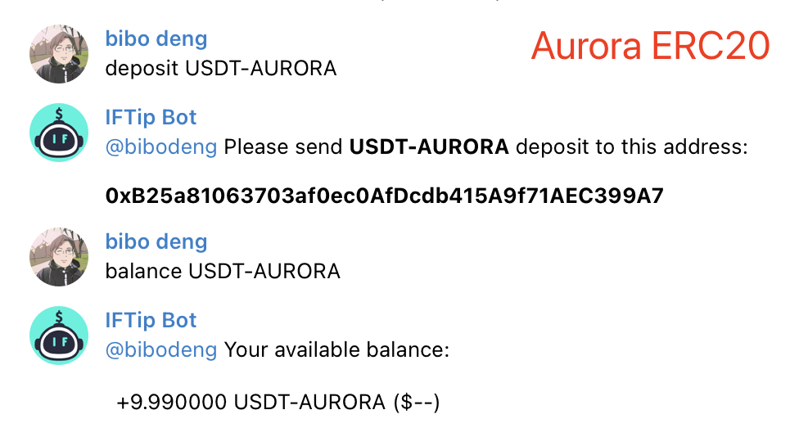
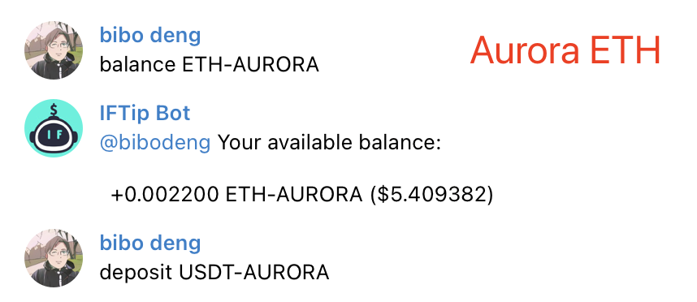
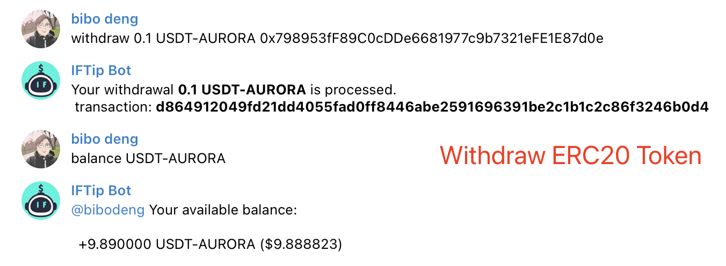
Demo

Slide 4
Demo Video
https://sourl.cn/rQnsMq

Slide 5
Structure
IFTip Bot
Wallet SDK
Intent Recognition
Aurora Blockchain
SNS SDK

Slide 6
Wallet SDK
Wallet Generation
Contract Interaction
RPC Balance Query

Slide 7
Next Step
1. Using smart contract to airdrop
2. Using smart contract to advertising airdrop
3. Support rainbow bridge interaction
4. Using DEX real time price quotation

Slide 8
IFTip Bot Connect you with blockchain via SNS network
Wechat: bibodeng
Email: bibodeng@gmail.com

